Slide 1
AI-powered Emergency Response
System
Enhancing efficiency and effectiveness in crises

Slide 2

Introduction
This presentation explores AI-powered emergency response systems, their significance in modern crises, and how they enhance decision-making and management during emergencies.

Slide 3
01
Overview

Slide 4

Definition of AI-powered emergency response systems
AI-powered emergency response systems utilize artificial intelligence technologies to enhance communication, coordination, and decision-making in emergency situations. These systems integrate data from various sources, including social media, sensors, and geographic information systems, to provide real-time insights and streamline response efforts.

Slide 5

Importance in modern emergency management
The integration of AI in emergency response is crucial for improving response times, ensuring resource optimization, and enhancing situational awareness. AI systems can predict disasters, allocate resources effectively, and improve communication between various emergency services. Consequently, they lead to better outcomes for affected populations.

Slide 6
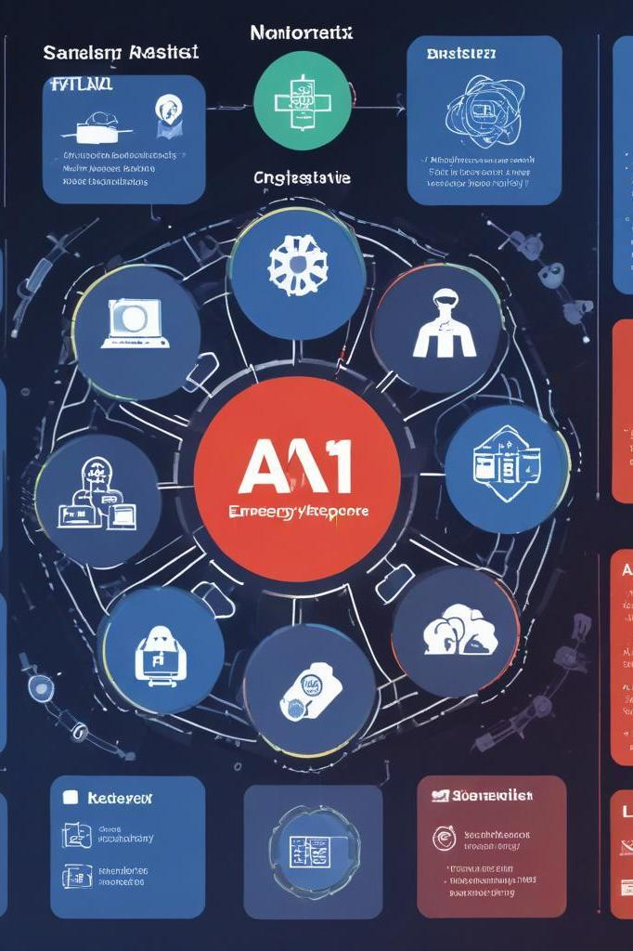
Key components and technologies used
AI-powered emergency response systems are built on several key components, including machine learning algorithms, data analytics platforms, geographic information systems (GIS), communication technologies, and Internet of Things (IoT) sensors. These elements work together to collect data, process it in real-time, and facilitate informed decision-making, ultimately leading to more effective emergency responses.

Slide 7
02
Applications

Slide 8
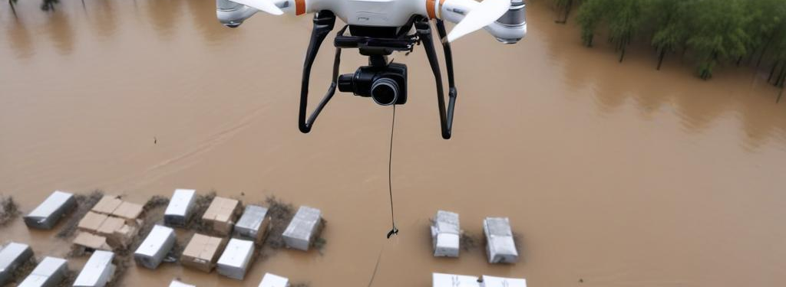
Disaster response and recovery
AI systems play a critical role in disaster situations, providing predictive analytics to assess risks and optimize response strategies. They can model potential disaster outcomes, suggest evacuation routes, and prioritize resource allocation. After a disaster, AI helps in assessing damage and coordinating recovery efforts efficiently, ensuring timely aid to affected communities.

Slide 9
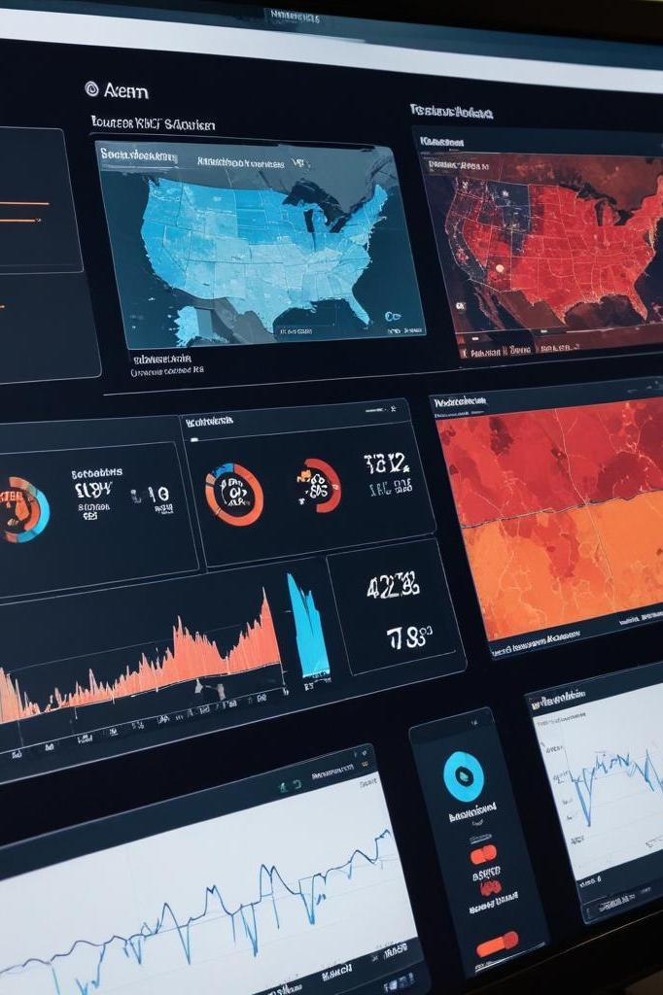
Real-time decision support systems
These systems leverage AI to provide emergency personnel with real-time data and insights. By analyzing incoming information, AI can suggest recommendations for action, track resources, and monitor evolving situations. This enhances situational awareness, allowing responders to make informed decisions quickly and effectively during crises.

Slide 10

Integration with existing emergency services
AI-powered systems are designed to work alongside traditional emergency services by enhancing their capabilities. They facilitate better communication and data sharing among various agencies, leading to more coordinated responses. Integrating AI technology helps traditional services improve their efficiency and effectiveness while still relying on human expertise and judgment.

Slide 11

Conclusions
AI-powered emergency response systems represent a transformative approach to managing disasters and emergencies. By leveraging sophisticated technologies and data analysis, these systems improve response times, enhance decision-making, and ultimately save lives. Their integration with existing services is pivotal for creating a cohesive and efficient emergency management framework.

Slide 12
Thank you!

